Slide 1

Problem Statement
How might we create a social networking app that fosters genuine connections and interactions while maintaining security and privacy.

Slide 2
Group-12
Rohitaaswa Chinnareddivari (SE20UECE071)
Worked on Figma and overall Idea of the Project (Team Leader)
Krishna Swamy Kota
(SE20UECE037) Worked on Figma
Siva Chinmai Varma Bhupathiraju
(SE20UECE085)
Worked on PPT, Figma and the Project Idea
Anay Kedia (SE20UECE006)
Worked on User Persona and user research.
Naga Pavan Mahesh Bolisetti
(SE20UECE049) Worked on Forms and Figma
Varun Sai Pokala (SE20UECE101) Worked on PPT and Figma
Pravallika Nori (SE20UECE104)
Worked on Forms and User Research

Slide 3
Competitive Research
Direct competitor: Instagram.
Instagram has a chat and reels option.
Doesn't have a strict time limit.(just a notification isn't going to help)
Lot of users complain about being suggested irrelevant reels and ads.
Has faced allegations of data theft in the past.

Slide 4
Key findings from User research
Most used Social networking apps are Instagram and WhatsApp.
The primary objective of users when using these apps is to engage in conversations and share content.
Roughly 50% of the users believe that their data is adequately protected and secure.
Users express concerns about excessive online time and express a strong need for a time limiter.

Slide 5
Continued..
Over 80% of the users prefer dark mode over light.
User are interested in getting recommended different communities to join.
Users find irrelevant ads and content to be disruptive and bothersome during their social media experience.

Slide 6
Before user research
We defined the goals and objectives of this user research.
These goals and objectives include to know:
How often people engage with social networking applications.
How satisfied they are with our current competitors.
The additional features they desire to have incorporated.
We decided to be open-minded and listen to the feedback.
We decided to go into research without any preconceived notions about what user want or need.

Slide 7
After User research
We first analyzed the collected data to identify any recurring patterns and key insights.
We took some time to prioritize our findings as not all data collected is equally important.
We incorporated our findings into our design.

Slide 8

User Persona & User Journey

Slide 9
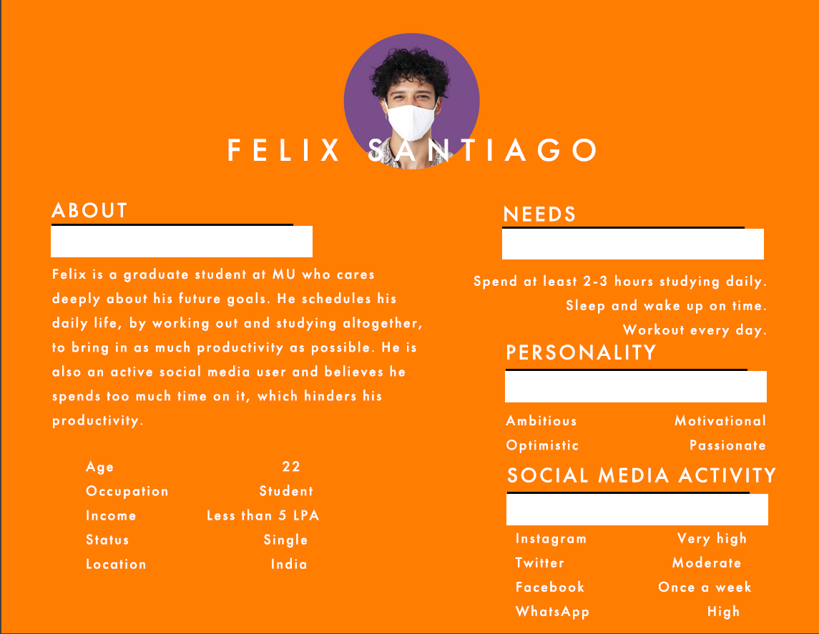

Slide 10
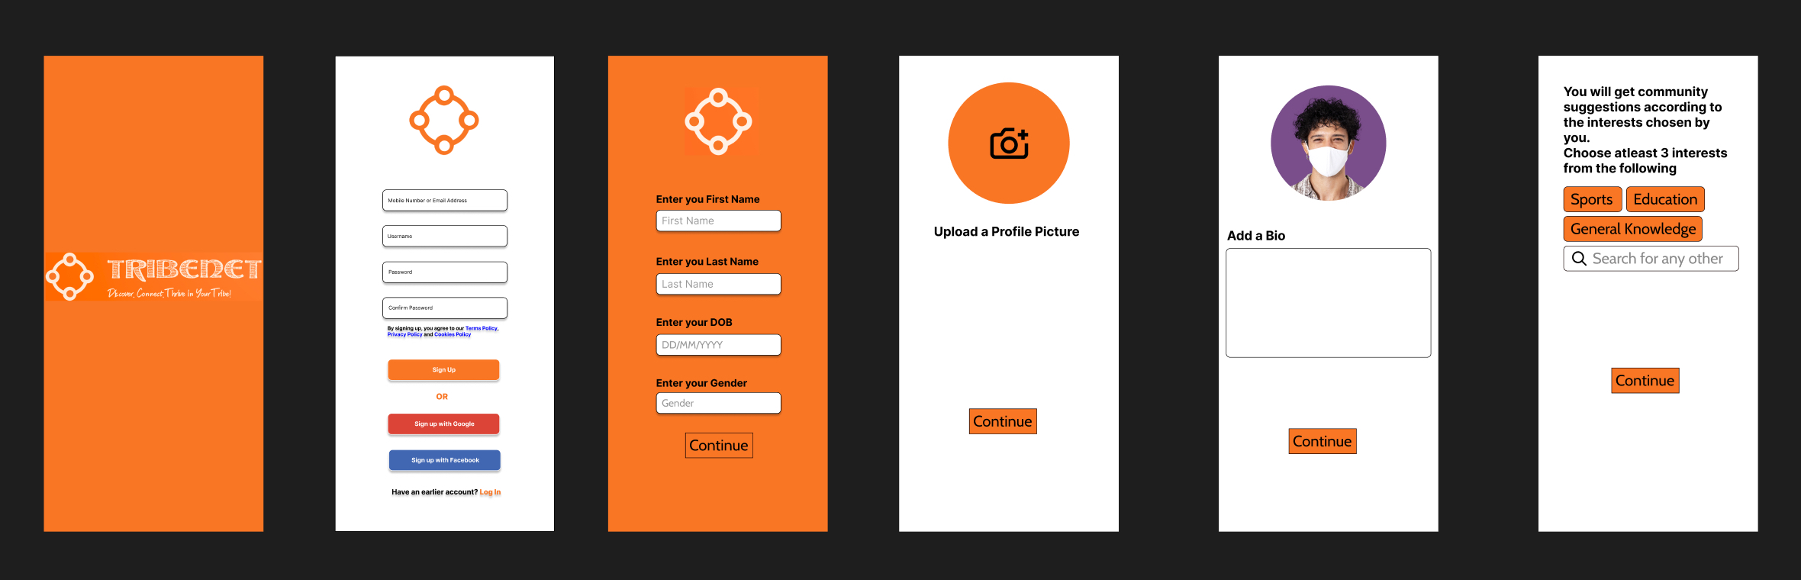
User journey for Signup

Slide 11
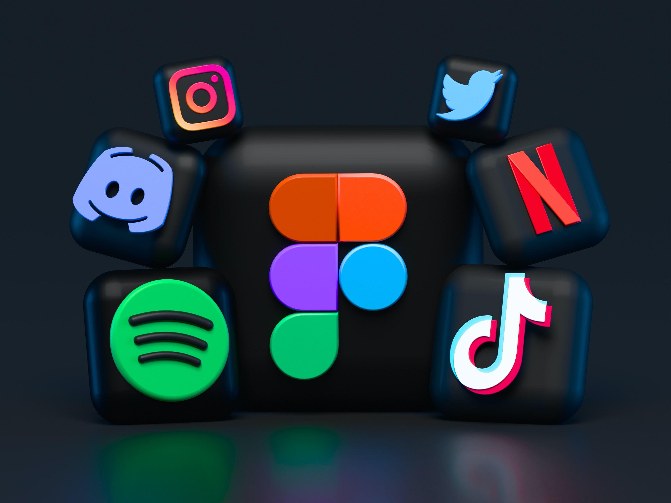
Figma Link:
https://www.figma.com/file/JGqYg8BRGMk7CQekEpL7o8/Project-of-the-course-UI%2FUX-Design?type=design&node-id=0%3A1&t=HWN6GoXb0KsNEwxn-1

Slide 12
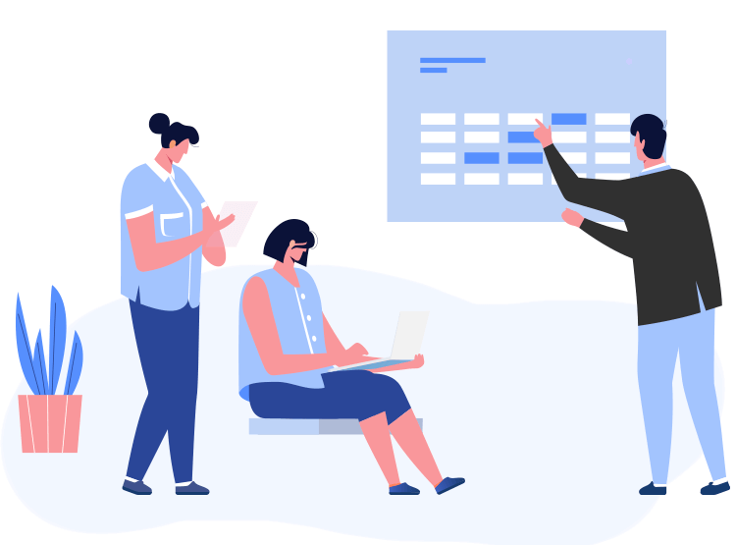
Post User Testing

Slide 13

Received Feedback
A few users requested to place the "signup with Google" button a bit higher as most people do signup with Google if it is a possibility.
3 Users wanted the search icon to be in the middle of home page, but majority liked it where it is.
6 Users requested a download option.
Mostly positive reviews on the idea of implementation of Communities feature.
Users requested for a progress bar under reels to know how long it is still going to play

Slide 14
Received feedback continued...
A few users asked for a toggle button to change the theme from dark to light and vice versa.
We gave the users 2 different types of dark themes(a lighter greyish version and a pitch-black version) and asked them what they preferred. Most users picked the lighter greyish version.

Slide 15
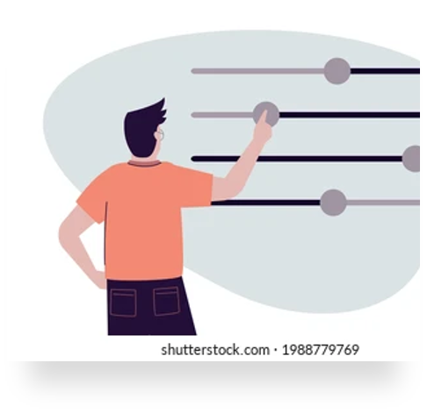
Considered changes
Added a progress bar under reels.
Added a toggle button to switch theme.

Slide 16
Conclusion
At the beginning of the project, we started with the theoretical knowledge we gained from classes and implemented them in our research and testing phases of the project.
Through our project, we gained an understanding that the design process is iterative, and with each iteration, our prototype improved.
Throughout the duration of the project, we acquired the ability to adapt and remain flexible in our approach.
We have learned to strike a balance between aesthetics and functionality.

